Slide 1
Guarded Avenue
A Safe Area classifier for Women travellers

Slide 2

Use Case & Future Opportunities
Use Case: Identifying safe areas in a city, especially for women, to suggest best/preferable routes for travel
Other Application Areas:
Safe Travel - Can be used for pedestrians, Cabs or Public Transport
Examples – Ola, Uber, MeruCabs, Lyft
Hotels - Book hotels in safe place
Examples – Oyo, Airbnb, Yatra, MakeMyTrip, TripAdvisor
Housing Search - Helps in safe home searching by identifying safe localities
Examples – 99acres, MagicBricks, CommonFloor
HealthCare – Identifying safe hospitals during a crisis situation
Examples - Practo, Other hospital review portals
Intra city transit – Identifying safe zones for bike/cycle rentals for commute as well as parking

Slide 3
Solution Approach : Features Usable
Positive feature:
Street light, Traffic signal density
Mobile Tower Density
Bus Stops
Accident prone Area
Crime rate of area
Population Density
Metro Stations, Police station
Club, Bar, Restaurants, Cafes
Hospitals
Negative feature:
Lakes
Public Park, Resorts
Schools
Golf course, Historical place
Behavioural aspect:
location/Region specific
eg. Bangalore and Patna at 10 PM
Festival
Seasons
In our use case, we have chosen to identify safe or unsafe boroughs in New York City based on the average crime rate (calculated by complaints filed/person) and how well lit the streets are (calculated by street lights present/square km.)
[Adding more features according to the business goal will help us better predict safe areas/routes for travel]

Slide 4
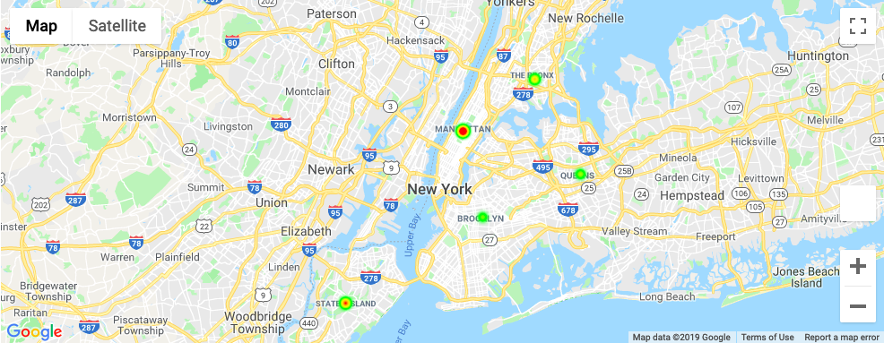
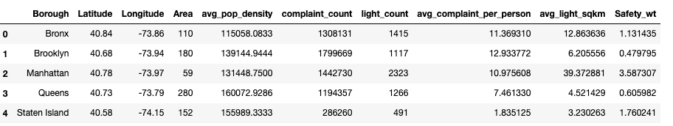
PoC Evidence
Images:
1. Snapshot of the final dataset.
2. Hotspots showing safe and unsafe boroughs in New York City [Red – safe, Green – Unsafe]
Insight: Manhattan and Staten Island come out to be the safer boroughs as compared to Brooklyn and Queens where the Bronx remains neutral-ish

Slide 5
Business Model
We plan to roll out the product as a B2B add-on, which can be used by the various industries mentioned earlier that have avenues for application of the solution
The estimated source of maximum revenue would be based on a fixed fee incurred on the Business using the add-on as per the number of hits through their site/app
At a later stage, more features as added services can be introduced (after research for purposeful implementation), which would be a premium service and would have a cost of use associated. The added services again depend on the final business goal at hand and will change as the industry of application changes
[ The data collected through usage of the application could also be fed back into the algorithm to increase the accuracy and probably identify features that could be included]

Slide 6
Go To Market Plan
Our business model largely depends on the usage of the API we present, hence the market expansion plan and ultimately the revenue generated, is directly proportional to how many business use it.
In terms of production and expense plan at our end, different businesses will require different versions, customised and tweaked for their specific business, so that provides us opportunities for income in terms of development and deployment + maintenance.

Slide 7
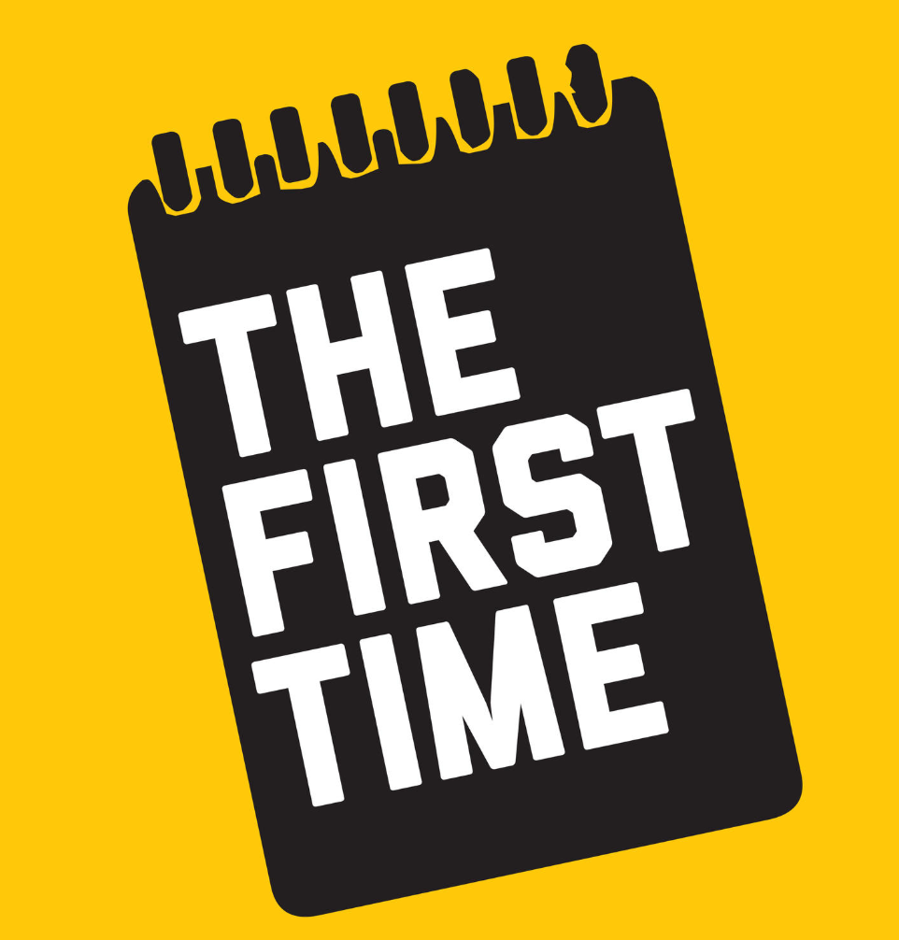
Initial Competitive Analysis
No fool proof solution is present in the market yet for identifying “Safe Zones”
The opportunity certainly seems promising!!

Slide 8


